Slide 1
BRAIN MENTOR
NEW GENERATION EXAMINATION CENTER
PRESENTATION BY ATUL ANAND
Roll No. 00811604415

Slide 2
CONTENTS
Introduction
Objectives and Concentrations
Technologies Used
System Design
Screenshots
Conclusion
Limitations
References

Slide 3

INTRODUCTION
On-line Exam System is very useful for Educational Institute to prepare an exam, safe the time that will take to check the paper and prepare mark sheets. It will help the Institute to testing of students and develop their skills. But the disadvantages for this system, it takes a lot of times when you prepare the exam at the first time for usage. And we are needs number of computers with the same number of students.
The effective use of "On-line Exam System", any Educational Institute or training centers can be use it to develop their strategy for putting the exams, and for getting better results in less time.

Slide 4
Users of ScalaGeek are classified into Four categories:
Administrators
Administrators are responsible for management of system users, subjects, tests, questions, results, system backup and recovery etc.
Users
Users can be the recruiters(Paid user).
Users can be the candidates appearing for the examination.
Users can be the geeks testing their scala skills.

Slide 5

OBJECTIVES AND CONCENTRATIONS
Corporate between the data stored in the server of the Institution and our On-line Exam system. To deal with On-line System in an easy way and an efficient mannered. (connection process)
Create strong and secrete data base that allow for any connection in a secret way, to prevent any outside or inside attacks.
Specify a privilege for each person to allow each person use this system to create his own exam. And have a complete control on his exam.
Allow each person to create more than one exam with different way to create variant questions.

Slide 6

TECHNOLOGIES USED
This project is a web application that is developed in ASP.NET having DB2 as back end.
Front End-
HTML 5
CSS
AJAX
Javascript
Back End-
Java
Hibernate/Spring data JPA

Slide 7

SYSTEM DESIGN

Slide 8
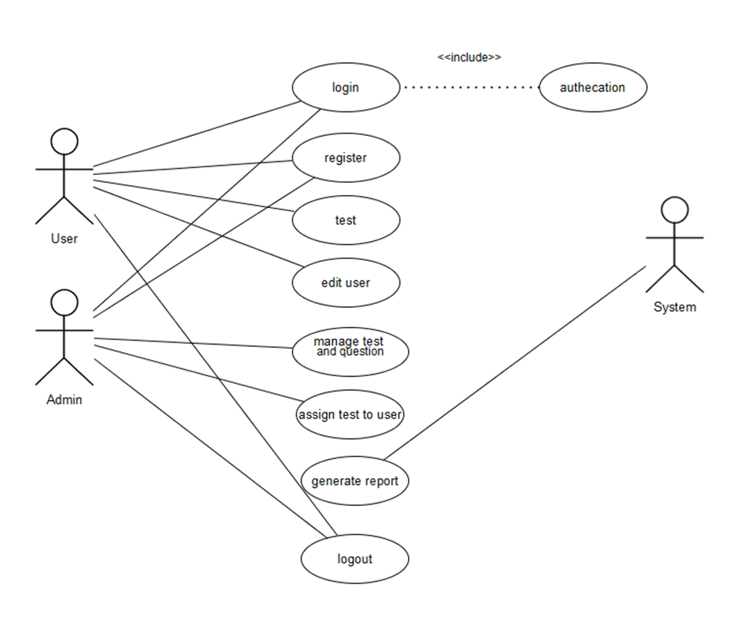
USE CASE DIAGRAM

Slide 9
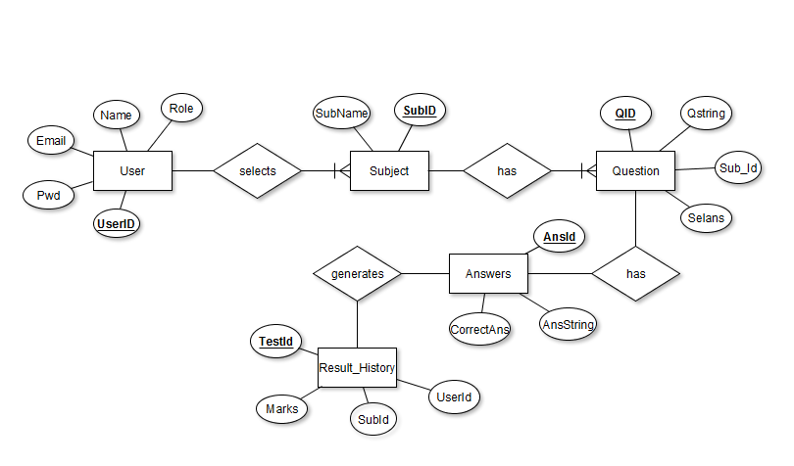
ENTITY RELATIONSHIP DIAGRAM

Slide 10
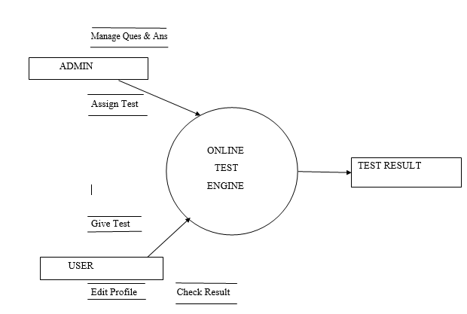
CONTEXT LEVEL DIAGRAM (LEVEL 0 DFD)

Slide 11
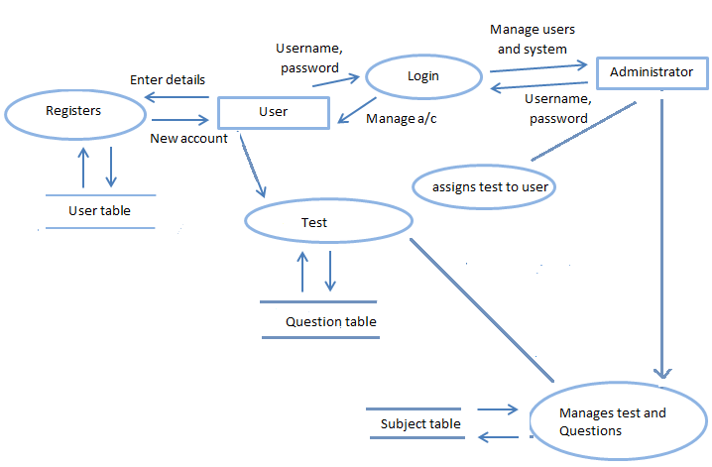
LEVEL 1 DFD

Slide 12

SCREENSHOTS

Slide 13
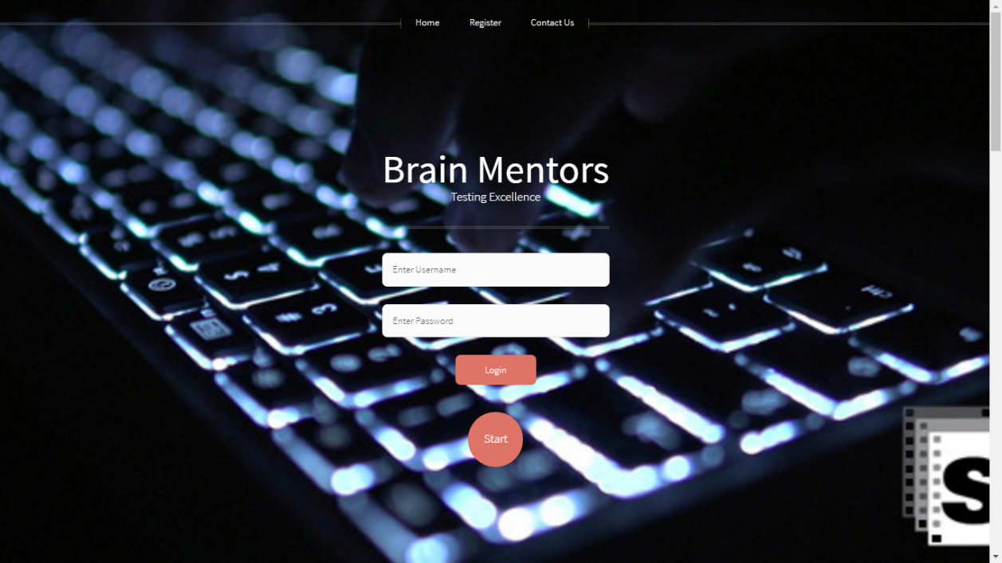

Slide 14
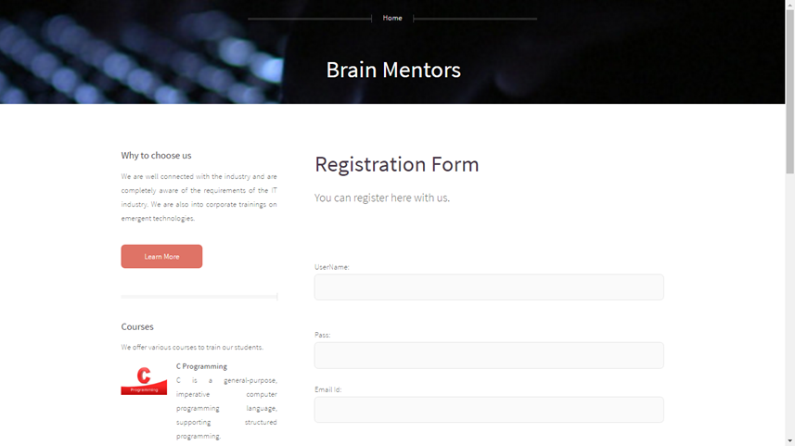

Slide 15
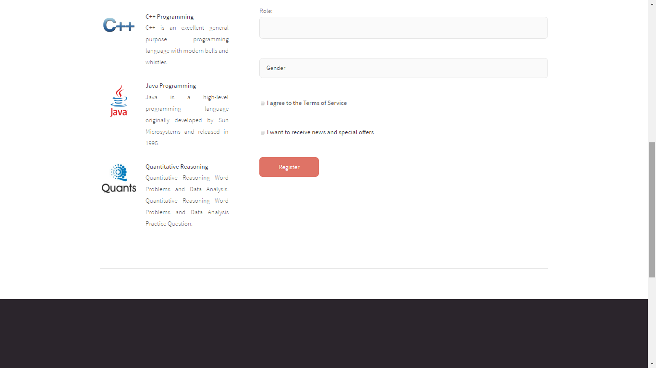

Slide 16
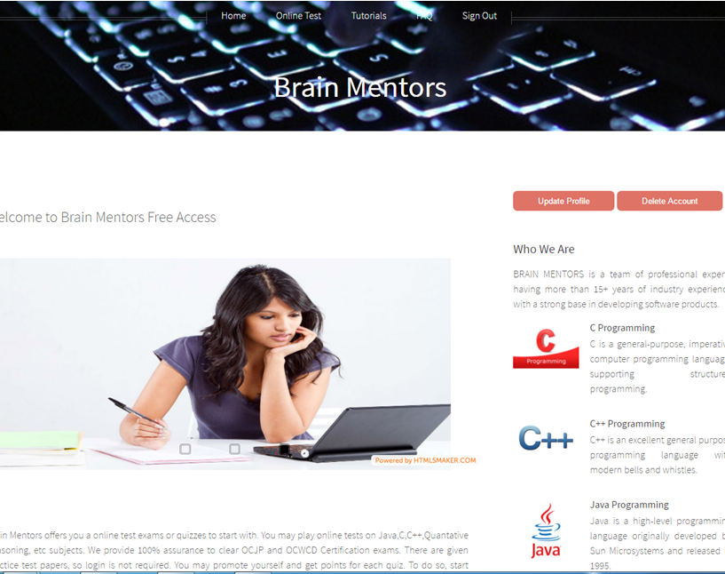

Slide 17
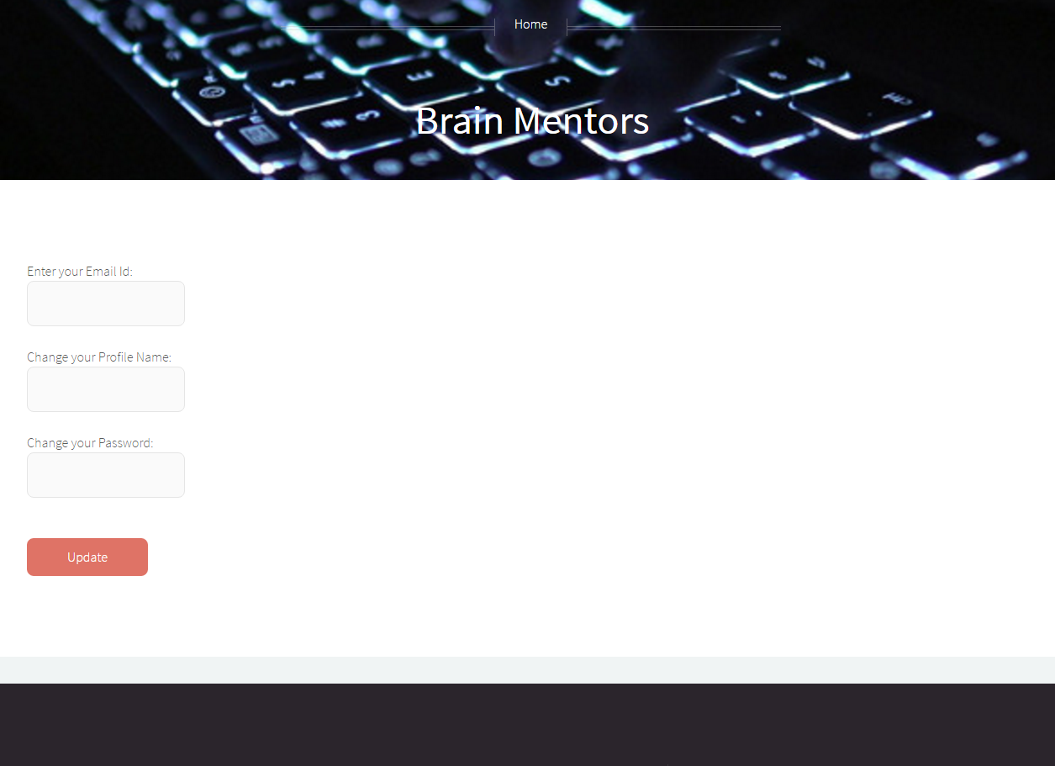

Slide 18
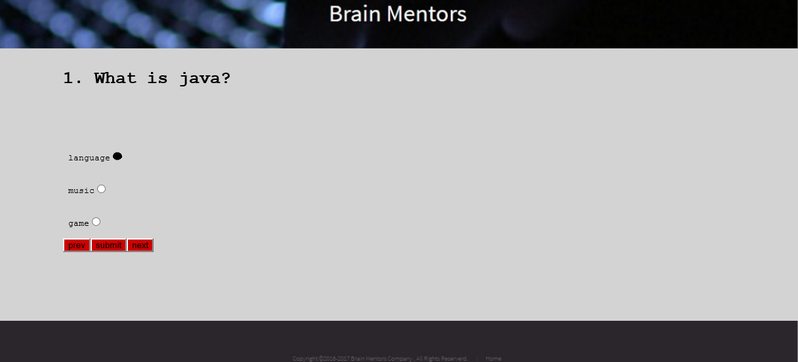

Slide 19
CONCLUSION
The project work assigned to us has been completed to our satisfaction and
we have added significant knowledge to ourselves.
This System has some limitations which can be removed
by making enhancements to the System

Slide 20
LIMITATIONS
This system capable of handling only objective type of question.
Time per question facility is not included.
Cannot generate random sequence of questions.

Slide 21
REFERENCES
http://www.javatpoint.com/spring-tutorial.
http://mvnrepository.com/
http://www.designmantic.com/
http://stackoverflow.com/
http://www.pluralsight.com/training/Courses/TableOfContents/introduction-html5-css3
http://www.pluralsight.com/training/Courses/TableOfContents/css3-from-scratch
http://www.pluralsight.com/training/Courses/TableOfContents/jscript-fundamentals
http://www.w3schools.com/sql/
http://www.w3schools.com/css/
http://www.w3schools.com/js/
http://www.w3schools.com/jquery/

Slide 22


